Slide 1
LG's Optimization of EV Battery Manufacturing
Harnessing Industry 4.0 and AI Vision Solutions
PRESENTED BY Nora Guo, Yingwei Zhang, Grace Liu, Lulu Jiang
12/04/2024

Slide 2
Project Introduction
Background:
The growing EV market demands higher battery production efficiency and quality. As a core vehicle component, batteries directly impact range and user experience. However, high scrap rates from defects like assembly errors and welding issues cost manufacturers millions annually. Stricter carbon emission regulations further compel the adoption of greener, more efficient production methods.
Objective:
To optimize EV battery assembly process and quality control by leveraging Industry 4.0 technologies.
Core Focus:
To achieve these goals, our focus is on addressing the high scrap rate in battery production, a major contributor to significant cost waste. By identifying and solving critical manufacturing challenges, we aim to implement effective solutions that enhance production efficiency and quality.

Slide 3
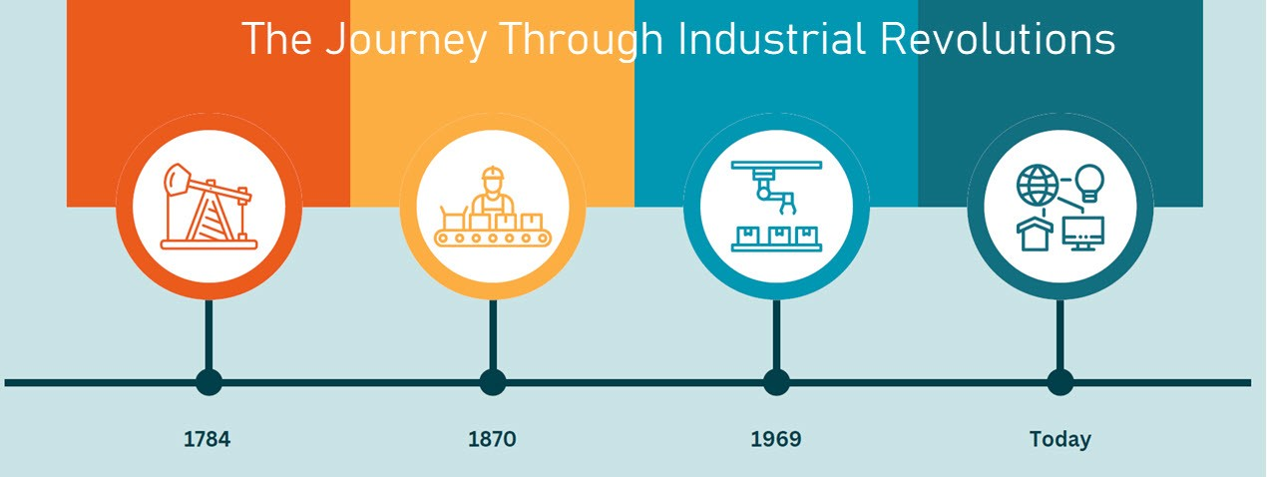
What is Industry 4.0?
Four Core Technologies (Relevant to EV Battery Production)
Internet of Things (IoT)
Artificial Intelligence (AI)
Augmented Reality (AR)
Big Data and Cloud Computing
Why Industry 4.0 for EV Battery Manufacturing?
Reduces high scrap rates caused by defects.
Enhances process reliability and quality control.
Provides scalable, cost-effective solutions for high-precision manufacturing.

Slide 4
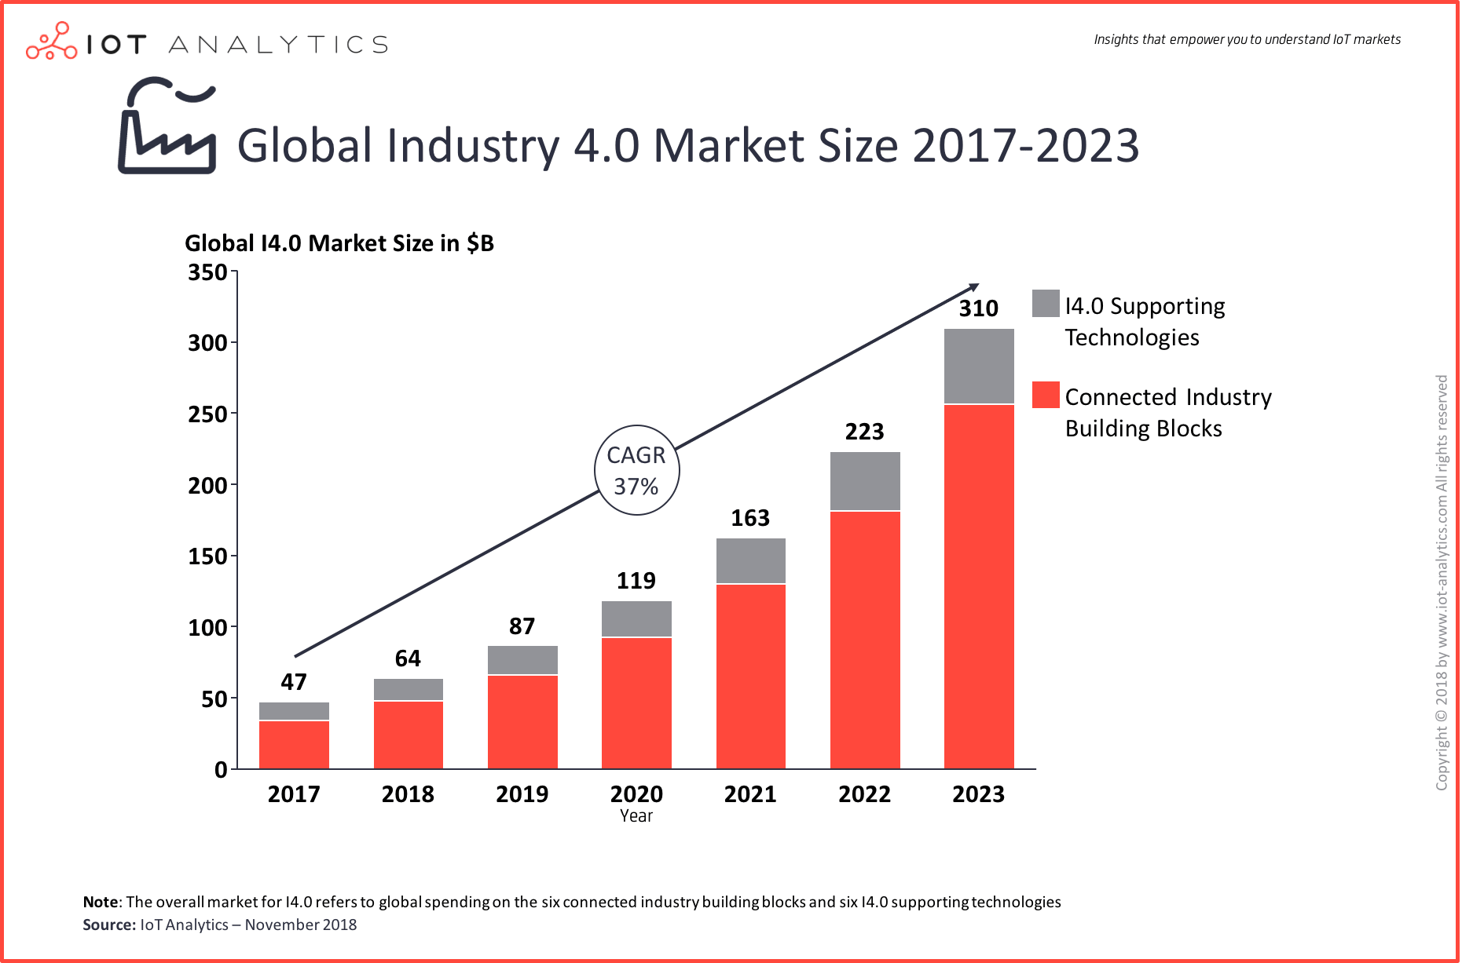
Current Industry 4.0 Manufacturing Trends
Adoption Trends
The global Industry 4.0 market grew from $47 billion in 2017 to $310 billion in 2023, with a compound annual growth rate (CAGR) of 37%.
Key growth areas include Connected Industry Building Blocks (e.g., IoT-enabled devices) and supporting technologies like AI, machine learning, and robotics.
This surge highlights the increasing reliance on smart manufacturing tools for scalability and sustainability.
Manufacturers utilizing Industry 4.0 technologies report a 25% increase in production efficiency and a 30% reduction in downtime, showcasing the impact of smart automation and real-time data analytics (PwC, 2023).

Slide 5


Applications of Industry 4.0 in Manufacturing
Comparison of other high precision manufacturing industries.
Medical Devices
Challenge: High precision required for component assembly.
Solution: AI and SPC+ reduced assembly errors, achieving 98% precision rates.
Impact: Significant decrease in product recalls, saving $1.2M annually.
Human-algorithm approach that reduced medical device recall rates by nearly 39%, resulting in annual savings of up to $2.9 billion (Harvard Kennedy School, 2024).
Semiconductor Manufacturing – AI Vision Systems (Schlosser et al., 2019)
Challenge: Detect microscopic defects on wafers.
Solution: AI Vision Systems identified scratches and misalignments with 95% accuracy.
Impact: Reduced inspection time by 40% and defect rates by 25%.

Slide 6
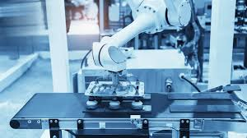
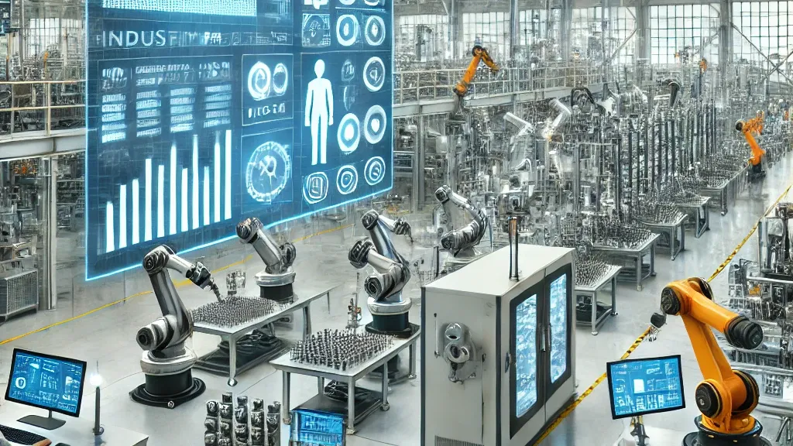
Applications of Industry 4.0 in Manufacturing
Automotive Industry
Challenge: High scrap rates due to welding defects in EV batteries.
Solution: AI vision systems like RICOH SC-20 detect weld misalignments and defects in real-time, while SPC+ tracks defect trends and optimizes welding parameters.
Impact: Scrap rates reduced by 40%, saving $3M annually. Downtime decreased from 5 hours/week to 1 hour/week, boosting productivity (Automotive News, 2024)
Watchmaking and Precision Instruments
Challenge: Micrometer-level accuracy needed for intricate components like gears and springs.
Solution: AI vision systems combined with SPC+ ensure micrometer-level accuracy by inspecting intricate components for defects and optimizing production processes in real time.
Impact: Enhanced durability and performance, increasing product lifespan by 20% and sales by $500M (Swiss Watchmaking Federation, 2023).

Slide 7

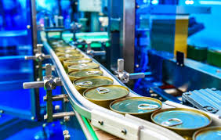
Applications of Industry 4.0 in Manufacturing
Aerospace Assembly – SPC+ (Merriman, 2021)
Challenge: Ensure precision in aircraft component assembly.
Solution: SPC+ monitored processes, flagged deviations, and reduced variability.
Impact: Lowered defects by 25% and improved on-time delivery.
Food and Beverage Industry
Challenge: Contaminants and inconsistencies in food packaging.
Solution: AI vision systems inspect sealed packages for defects and contaminants, while SPC+ tracks production trends to improve sealing equipment settings.
Impact: Reduced defective packages by 30%, saving $15M annually in recalls and waste (Food Manufacturing Journal, 2023).
Notes:
EV Battery Manufacturing is a high precision manufacturing process. So, here is a comparison of other high precision manufacturing industries.

Slide 8


Applications of Industry 4.0 in Automotive Manufacturing
Automobile Industry
BMW – AI Vision Systems (Landing AI, n.d.)
Challenge: Detect welding and surface defects during assembly.
Solution: Automated real-time defect detection improved efficiency.
Impact: Increased defect detection by 30%, reducing downtime by 20%.
Tesla – IoT and Big Data (McKinsey & Company, 2020)
Challenge: Reduce equipment failures.
Solution: IoT sensors enabled predictive maintenance via big data analytics.
Impact: Decreased unplanned downtime by 50%, boosting efficiency by 20%.

Slide 9
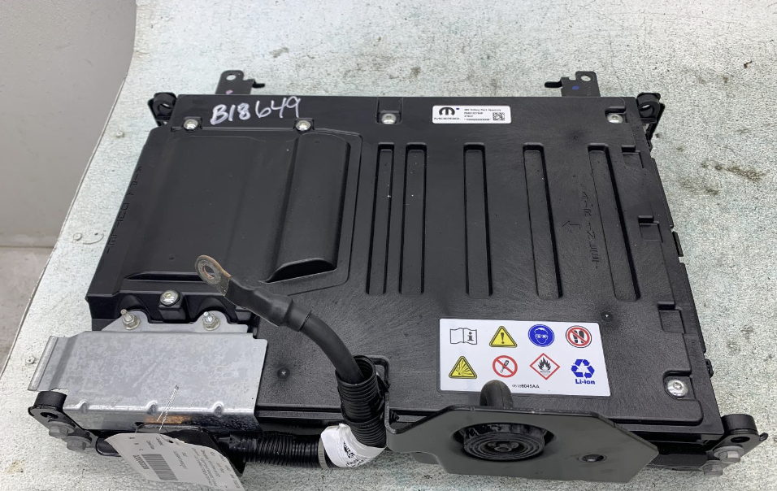
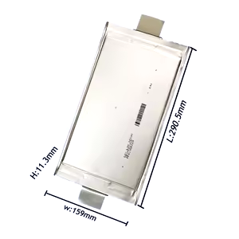
Key Challenges in EV Battery Production
Addressing the Biggest Loss Driver: Punctured Cells
Punctured cells during material handling and transfer are the primary contributor to high scrap rates, leading to significant financial losses.
Mild-hybrid pack line incurs $300,000 worth of punctured cells annually.
Defects lead to:
Scrap rates increasing beyond industry standards.
Higher rework costs and production inefficiencies.
Potential Recalls
Other Issues:
Connector Not Connected to ICB:
Impacts module electrical performance, leading to failures.
Damaged Thermistor Wires:
Wire damage during installation results in sensor malfunction.
Misaligned Cell Weld Positions:
Leads to short circuits, internal cell damage and module failure.
Notes:
Format a little differently. 4 issues in manufacturing → We picked 1 most high scrap generating process → Details about the process $300,000 loss just from 1 mild-hybrid battery pack line

Slide 10
Technologies to Focus on
Through an evaluation of 4.0 technologies, AI Vision Systems and SPC+ were identified as the most effective for addressing critical challenges in EV battery production:
AI Vision Systems:
Real-time defect detection (e.g., welding defects, misaligned components, and surface imperfections).
Reduces scrap rates by addressing defects before modules are fully assembled.
Offers high precision, essential for battery safety and performance.
SPC+ (Statistical Process Control Plus):
Detect and predicts process variability, ensuring consistent quality.
Analyzes real-time and historical production data for predictive maintenance.
Reduces downtime and improves production reliability.

Slide 11
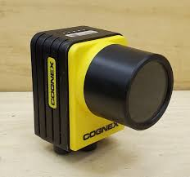
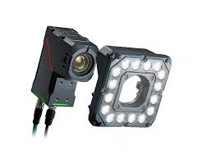
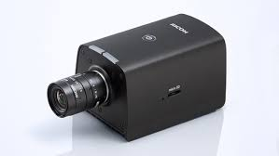
Vision Systems in the Automotive Industry
Vision Systems | Key Features | Applications | Examples in Automotive
Cognex | High-precision detection for assembly misalignments and weld defects. | Weld inspection, surface defect detection, gap analysis. | Detects weld alignment in chassis and frame assemblies.
Keyence | Compact, high-speed image processing; 2D and 3D capabilities. | Painted surface inspection, scratch detection, dimension measurement. | Identifies scratches and inconsistencies on car bodies.
RICOH SC-20 | High-resolution 3D imaging, compact design, and real-time analysis. | Detection of cell punctures, cracks, and welding defects. | Identifies punctures in EV battery cells and monitors weld integrity in module assembly.

Slide 12
Solving the Issue: Punctured Cells
RICOH SC-20 Vision Solution
High-Resolution 3D Imaging:
Utilizes an 8-megapixel CMOS sensor for superior image clarity.
Detects cracks, punctures, and assembly errors with high precision, ensuring improved quality control.
Supports texture matching evaluations, ensuring precise inspection of small parts and assembly alignment.
Automated Defect Detection and Removal:
Inspects critical components like battery cells in real-time.
Detects issues such as missing parts and misaligned assemblies to reduce defects.
Eliminates reliance on manual visual inspections, saving time and improving consistency.
Impact:
Scrap Reduction: Reduces battery scrap rates significantly, contributing to annual cost savings of over $300,000 for a single production line.
Efficiency Gains: Streamlines the inspection process, significantly enhancing production flow and reducing delays.
Enhanced Quality: Improves overall work quality by minimizing errors unlike manual processes.
Notes:
Verify the numbers

Slide 13
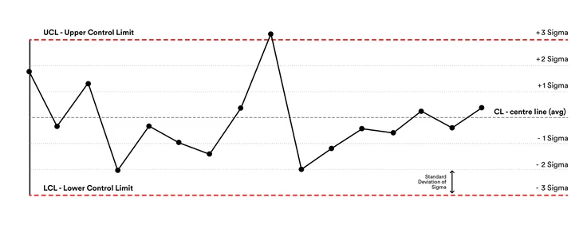
Solving the Issue: Punctured Cells
SPC+ Integration
Defect Trend Tracking:
Analyzes real-time production data to identify recurring material or handling issues.
Detects patterns in puncture occurrences, enabling predictive improvements.
Process Optimization:
Flags early warning signs of process inefficiencies, such as misalignment during welding or inconsistent sealing pressure, reducing risks of defects like punctured cells.
Impact:
Downtime reduction: From 5 hours/week to 1 hour/week by identifying preventative maintenance opportunities.
Enhanced process reliability, ensuring consistent quality.

Slide 14
Other Issues
Key Solutions
Connector Not Connected to ICB: RICOH SC-20 detects insertion depth and misalignment in real time, while SPC+ analyzes defect trends to prevent future issues.
Damaged Thermistor Wires: High-resolution imaging identifies damaged wires, and SPC+ provides maintenance insights for optimizing routing and tension.
Misaligned Cell Welds: RICOH’s 2D imaging detects misaligned welds, and SPC+ analyzes welding data for continuous improvement.
Integrated Solutions
RICOH SC-20 Vision System: Detects and prevents defects in connectors, wires, and welds, reducing errors.
SPC+ Optimization: Tracks and resolves defect trends, enhancing production reliability and efficiency.

Slide 15
Combined Benefits
Integrated Benefits of RICOH SC-20 Vision & SPC+
Enables comprehensive defect detection, improving product quality.
Provides dynamic production adjustments, reducing scrap rates and downtime.
Annual savings estimated at $300,000 while enhancing overall efficiency.
An investment of $3,300 brings significant returns, saving nearly $300,000 annually. By introducing AI vision systems and SPC+, module scrap rates are significantly reduced, production efficiency is improved, and the company's annual savings goals are met.
Annual Savings: $300,000
Investment Cost: $3,300
Net Benefit: $300,000 - $3,300 = $296,700
ROI: (296,700/3300)*100=8990%
Item | Cost (USD)
RICOH SC-20 Hardware | $2,000
Accessories and Mounts | $300
SPC+ Integration | $1,000
Total | $3,300
Notes:
Add ROI → Return on Investment. Add ROI calculation for this.

Slide 16
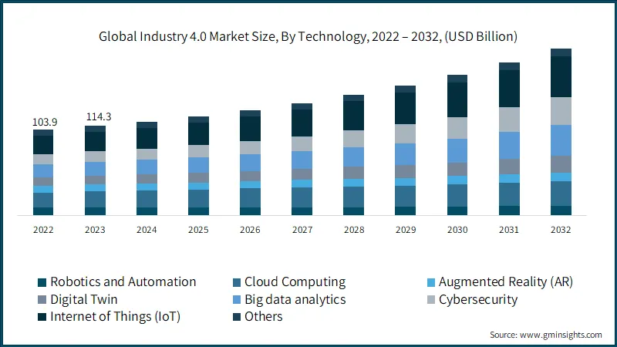
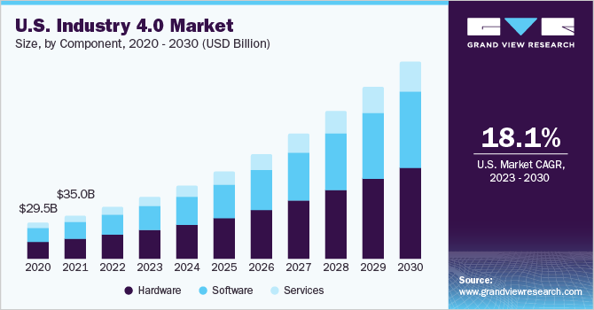
Conclusion & Future Outlook
Global Adoption of Industry 4.0 Technologies:
The Industry 4.0 market is projected to grow from $210B in 2023 to $310B by 2030, driven by AI, IoT, and automation (Precedence Research, 2023).
Automotive Industry Growth:
Industry 4.0 tools like AI Vision Systems and SPC+ are becoming industry standards for high-precision manufacturing.
By 2030, it is estimated that 70% of automotive manufacturers will use AI-powered systems for defect detection.
Industry 5.0:
Industry 5.0 in electric vehicles focuses on human-machine collaboration, customization, sustainability, and worker empowerment.

Slide 17
References
Argano. (n.d.). Opportunities and challenges for lights-out manufacturing. Retrieved December 7, 2024, from https://argano.com/insights/articles/dark-factories-opportunities-and-challenges-for-lightsout-manufacturing.html
Automotive News. (2024). Defect reduction in EV battery production. Retrieved from automotivenews.com.Boeing Annual Report. (2023). Precision manufacturing in aerospace. Retrieved from boeing.com.
EV Battery Manufacturing. (n.d.). Honeywell launches new AI-powered battery manufacturing software, reducing scrap by up to 60%. Retrieved December 7, 2024, from https://evbatterymanufacturing.com/p/honeywell-launches-new-ai-powered-battery-manufacturing-software-reducing-scrap-by-up-to-60
Food Manufacturing Journal. (2023). AI and SPC in food production quality control. Retrieved from foodmanufacturing.com.
Harvard Kennedy School. (n.d.). Human-algorithm approach for approving medical devices could save billions. Retrieved December 7, 2024, from https://www.hks.harvard.edu/faculty-research/policy-topics/health/human-algorithm-approach-approving-medical-devices-could
Harvard Kennedy School. (2024). Economic impacts of AI in medical device manufacturing. Retrieved from hks.harvard.edu.
Industry 4.0 market size, share and Growth Report, 2030. Industry 4.0 Market Size, Share And Growth Report, 2030. (n.d.). https://www.grandviewresearch.com/industry-analysis/industry-4-market-report
Landing AI. (n.d.). AI for manufacturing quality control - Visual inspection AI. Retrieved from https://landing.ai/case-studies/redefining-quality-control-with-ai-powered-visual-inspection-for-manufacturing
Merriman, K. (2021). Statistical process control implementations within the aviation industry. Proceedings of the International Conference on Industrial Engineering and Operations Management. Retrieved from https://soar.wichita.edu/bitstream/handle/10057/21739/d21025_Merriman.pdf
McKinsey & Company. (2020). Scaling AI in the sector that enables it: Lessons for semiconductor device makers. Retrieved from https://www.mckinsey.com/industries/semiconductors/our-insights/scaling-ai-in-the-sector-that-enables-it-lessons-for-semiconductor-device-makers
New market report uncovers 9 disruptive trends and ranks 12 key use cases transforming Smart Manufacturing. IoT Analytics. (2024, September 26). https://iot-analytics.com/industry-4-0-and-smart-manufacturing/
Schlosser, T., Beuth, F., Friedrich, M., & Kowerko, D. (2019). A novel visual fault detection and classification system for semiconductor manufacturing using stacked hybrid convolutional neural networks. arXiv preprint arXiv:1911.11250. Retrieved from https://arxiv.org/abs/1911.11250
Semiconductor Industry Association. (2023). Trends in semiconductor manufacturing. Retrieved from semiconductors.org.

Slide 18
Thank You！

